Slide 1
Build Your Own Personal GPT
Marc Brosey
TechBash 2023

Slide 2
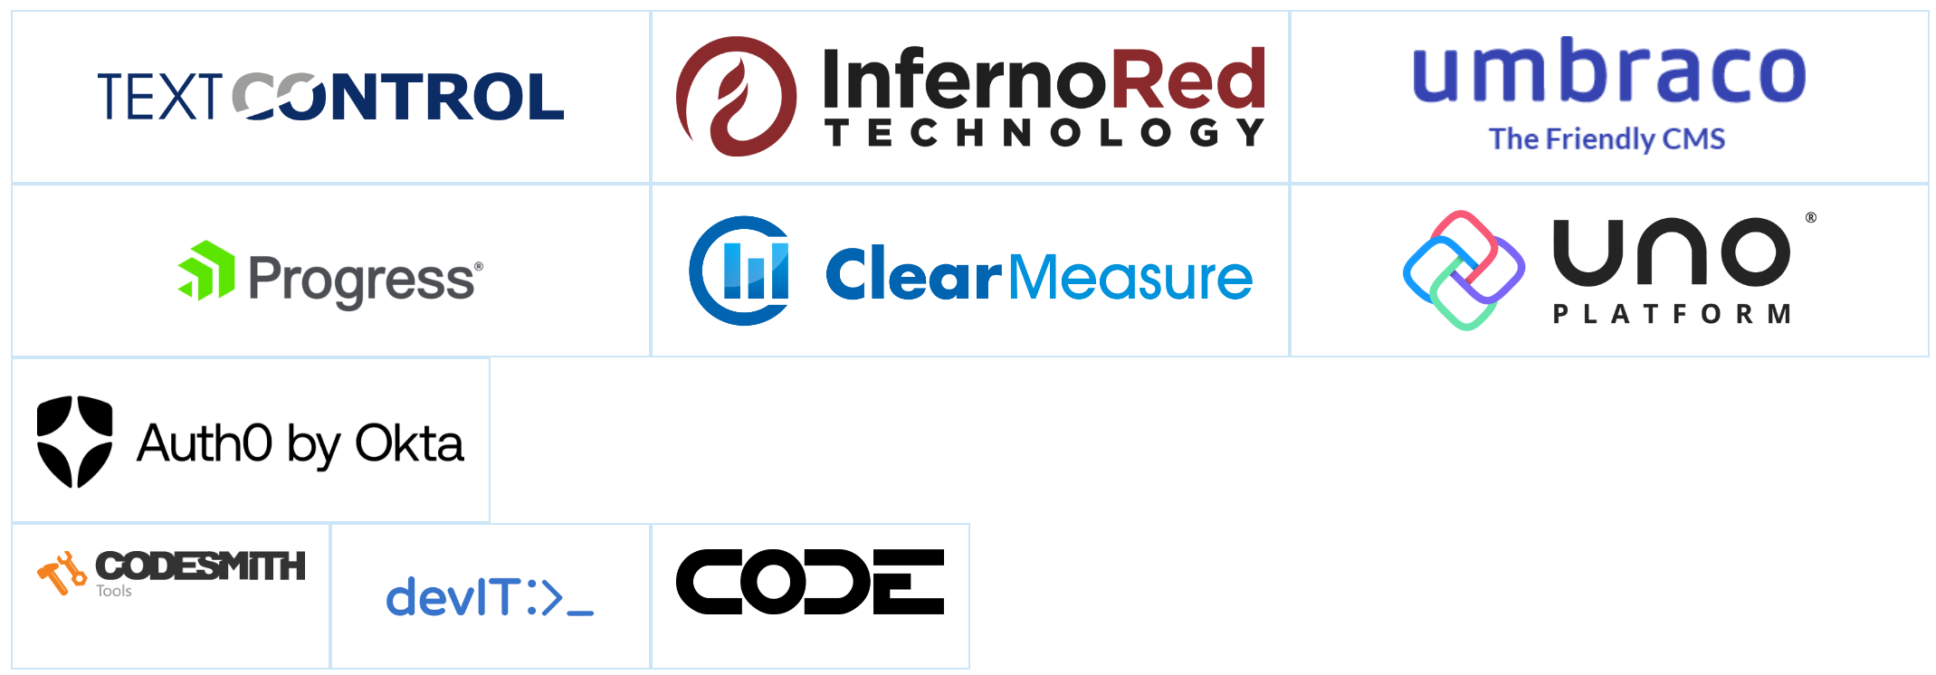
Thank you TechBash 2023 Sponsors!

Slide 3
Thank You Techbash 2023
TechBash is my favorite conference. I’m honored to be able to speak here.
Slide deck can be found at www.github.com/Marc-Brosey/TechBash2023
Most images in this slide deck were pulled from Wikipedia.

Slide 4
About Me
Software engineer for more than 15 years.
Continue to do full stack development.
Master’s degree in Information Security.
I just do Artificial Intelligence for fun. No special credentials in AI.
I want to live in a cyberpunk future, and I’m doing my part to achieve that.

Slide 5
In This Session…
A friend who speaks at tech conferences gave me this bit of advice, “Write the abstract for the talk you want to present, not the talk you have prepared.”
I took his advice and wrote the abstract based on the fantasy of what I’d like to present…
… Think talking android standing next to me and engaging in a panel discussion with me.
After the presentation was accepted by TechBash, I pulled my hair out for the next several months attempting to prepare this presentation.
I’m presenting here, all I learned to get started that fits in an hour.

Slide 6
What Did I Promise? (Months Ago)
I promised to provide a quick survey of what AI technologies are available to run locally. (We’ll see how quick)
Go over my journey to build and fine-tune my own local AI assistant.
Demonstrate how to run your own GPT AI models in real-time.
Before this, though, let’s talk about:
Why would I use local AI?
What is the current state of local AI?
Some terminology you will need to start your own AI journey.

Slide 7
Why Local AI? Have you Used Chat GPT?!?
Chat GPT is amazing.
I’ve already used it to write more software than I’d like to admit to.
And write more poems than I’d it to take credit for.
And help me craft jokes and write witty copy.
Chat GPT is a fantastic acquaintance, perhaps becoming something of a friend to me.
But Chat GPT is in the cloud. It has the best interests of OpenAI in mind.
I can pick Chat GPT’s brain like a fellow software engineer at the coffee machine, not like a business partner helping me build something meaningful.

Slide 8
What About Local AI In the Cloud?
Can I just use something like RunPod.io to just have my local AI models running in the cloud?
Yes, you can!
It’s faster, and depending on what you’re attempting to achieve, may be cheaper.
In many cases, options in the cloud seem to be better than options locally.

Slide 9
My Mentors
Matthew Berman - https://www.youtube.com/@matthew_berman
Has the greatest YouTube channel for all things AI.
He goes step by step on how to run all sorts of AI technologies.
Prompt Engineering - https://www.youtube.com/@engineerprompt
Another good YouTube channel. More educating, less entertaining.

Slide 10
Local AI is the New Microcomputer Revolution
Last century, in the 1900s, massive computers called mainframes inhabited the earth.
For decades, these were the only electronic devices called, ”computers.”
In fact, mini computers, smaller versions of mainframe computers were created to be a little less powerful, but also take up a little less space.
Anyone who wanted to use a real computer had to access it through a terminal.
When microcomputers came out in the late 1970s, they were very simplistic computing devices compared to their mini computer and mainframe ancestors.

Slide 11
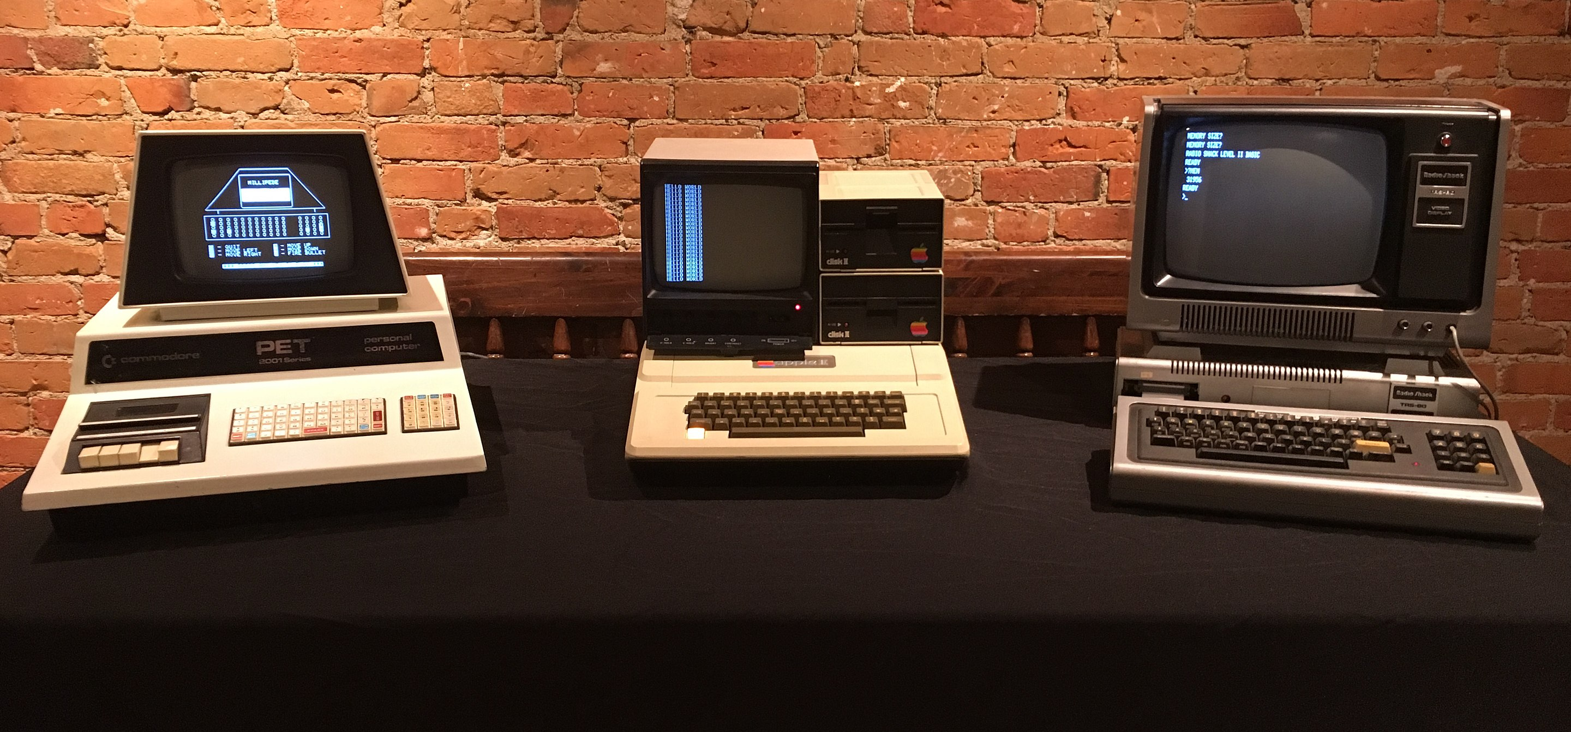
First Generation Microcomputers

Slide 12
First Generation Microcomputers
Early first-generation computers were really only accessible to engineers who liked to tinker and be early adopters of new technology.
Some of the earliest microcomputers required their users to write their own boot-loader to load the operating system.
Had one small processor, with one small block of memory (2KB – 8KB)
Processor responsible for primitive graphics and any other peripherals.
But not all engineers wanted to be early adopters.
Many said, “But I work all day on a mainframe or a mini computer that is way more capable than this little toy microcomputer. Why should I use it when I could just use my better computer through a terminal?”

Slide 13
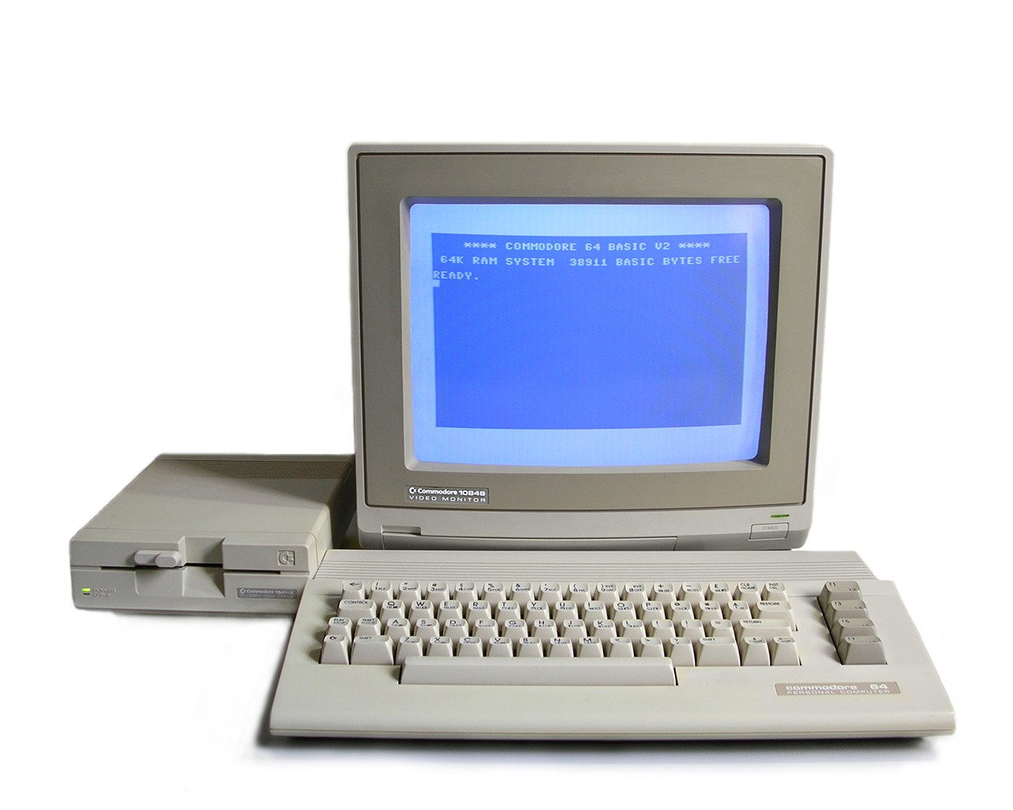
Next Generation Microcomputers
The Commodore 64 was the best selling computer of all time.
Over 12 million units were sold.
Way easier to use.
Way more capable.
More than just engineers owned and used these computers.
A lot of kids who grew up to be engineers used these computers.

Slide 14
What made the next generation of microcomputers better?
The first generation microcomputers could run one program at a time.
The programs were small. Had to fit inside a box the size of bytes or a few kilobytes.
The main CPU was the only processing unit available and had to be engaged in each bit of code that was run in each process.
Graphics were primitive. All monochrome. Usually no sound, or primitive bloop speaker.

Slide 15
What made the next generation of Microcomputers better?
The CPUs were largely the same, and not faster. There was more RAM, but not much more. How was such a leap in capability achieved?
Other specialized chips were added to take the load off the primary, general purpose CPU.
A graphics chip made color graphics possible.
Sound chips were added for better sound.
Other dedicated chips were added for more peripherals. Disk drives, hard drives, modems to connect to the internet.

Slide 16
You ARE HERE First Generation Local AI
We are currently in the first generation of local AI, the Apple I generation.
We have local, open source models, some of which rival some of the current capabilities of the free version of Chat GPT.
They mostly all do one general thing particularly well… slowly.
Unless the one thing they do well is to be fast, in which case that’s nearly the only thing they do well.

Slide 17
The Billion Parameter Wars
Who here can recall the great bit wars of the 1990s?
”My Nintendo is really great! It plays Mario!”
“That’s a baby’s toy. It’s only got 8-bits. My Sega Genesis has 16-bits and does what Nintendon’t!”
There was a real jump in capability between an 8-bit and 16-bit system. And from 16-bit to 32-bit. And a noticeable jump to N64’s 64-bit system.

Slide 18
The Billion Parameter Wars
The same thing is happening now with the number of parameters in AI models.
The standard large language model sizes are 7B (billion), 13B, 32 or 34B, or 70B parameter models.
All things being equal, you will tend to notice a 70B parameter model producing a better output compared to a 7B parameter model.
Given proper training, however, a specialized 7B parameter model can outperform a 70B parameter model on specific tasks.

Slide 19
Let’s Back-Up For A Moment
What is a Large Language Model? What is a GPT?
GPT stands for Generative Pre-trained Transformer.
What is a Transformer?
A Transformer is a type of Neural Network.
Large Language Models are the result of a trained Generative Pre-trained Transformer.

Slide 20
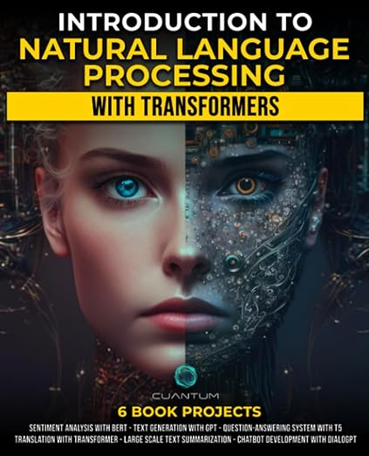
I Got Confused This book Helped

Slide 21
Introduction to Natural Language Processing With Transformers
Provides a wonderful introduction to the terminology of AI.
Goes over what a neural network is, the types of neural networks and what they are used for, and provides code examples in Python of how to build them using PyTorch and other libraries.
Introduces Transformers (a type of neural network) explains their architecture, and again provides code examples on how to build one.
Goes over the basics of how to build a GPT and large language models in general while providing code examples. It’s a little dated, focus on GPT-2.
Also provides a chapter on fine-tuning and how to accomplish that manually by rolling your own code.

Slide 22
Do I have to Learn this Much And do it from scratch?
No.
In the six months I prepared this talk, nearly everything I thought I was going to have to do from scratch using my own Python code and data got automated.
Knowing the basics and the terminology does help you know what to search for when using a search engine.

Slide 23
Huggingface.co
HuggingFace.co is like the Node Package Manager of AI.
They have a whole website chock full of AI models, training data, and sample code.
They serve as a literal repository from which you can pull AI models and training data from and push to from other programs.
The most popular models on the website are benchmarked and ranked so you can get a general idea of how good a particular large language model is compared to other ones in its class.
HuggingFace keeps a leader board of the highest performing AI models on their platform.

Slide 24
Text-Generation-Web-UI
Text-Generation-Web-UI is the best graphical user interface for debugging and testing AI models that I have seen.
https://github.com/oobabooga/text-generation-webui
You copy the name of the AI model you fancy to run on your local machine off of the HuggingFace.co website, and then paste it into the model downloader, click download.
Once downloaded, you click load, and then chat with the model. Chat GPT on your local machine. It’s that easy.
If you click on the extensions tab, you can setup various add-ons to the app. Clicking the extension marked, “API” allows you to communicate directly with your currently loaded AI model from another app via port 5000.

Slide 25
LM Studio
There is another UI interface for testing and using large language models. LM Studio has the look and feel of Visual Studio code, but it’s centered around doing work with AI models.
It also allows you to download AI models from within the app, even providing a search engine and browser for them.
In its attempt to be platform agnostic, not all HuggingFace models can be downloaded and loaded.
Also, if you read the license, it can only be used for educational and non-commercial purposes.

Slide 26
What Kind of Computer Do I need?
I love my MacBookPro, so I started with it.
At that time there wasn’t much I could do with it.
Most AI stuff ran on CUDA compatible hardware. (NVIDIA Graphics Cards)
GPTQ - GPT Quantization came out, allowing most GPT models to run on using the CPU instead of the GPU.
You could think of GPTQ as a method of AI model compression.
GPTQ is to a regular AI model as MP3 is to an audio wave file.
Tom Jobbins (TheBloke) has a profile on HuggingFace where he uploads a lot of open source models into GPTQ format for people without a powerful GPU to still have the pleasure of using.

Slide 27
I wanted to Go All In
In August, before kids go back to school, the state of Tennessee throws a tax-free holiday on all education-related merchandise.
This includes computers under $1,000.
Because computer dealers want to make a sale, computers that are usually more than $1,000 get marked down.
On tax-free weekend I purchased an HP Omen for $999.99, then ordered RAM to fill it to its 128GB max capacity.

Slide 28
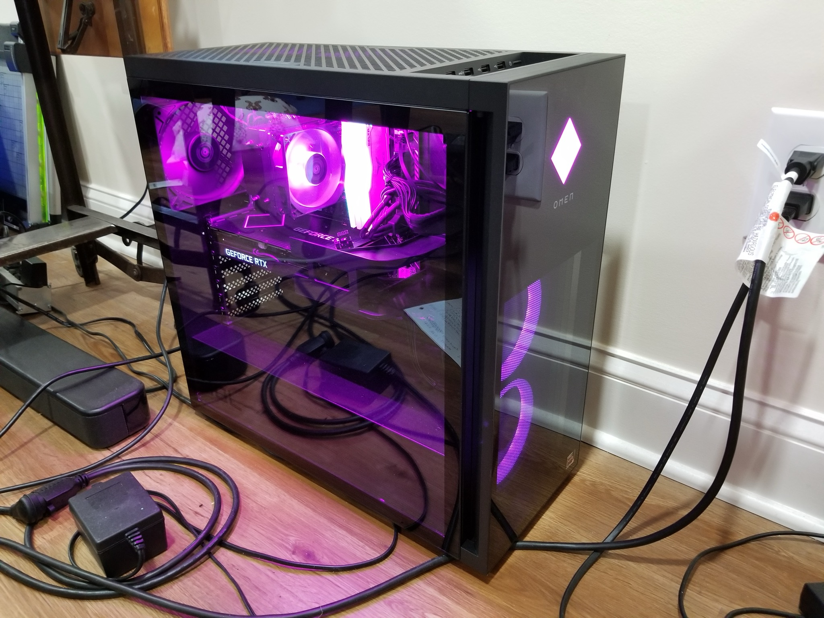
Meet Good Omen

Slide 29
Good Omen’s Specs
AMD Ryzen 5 5600G 3.9GHz processor with 6 cores.
128 GB 3600MHz DDR4 RAM
NVIDIA GeForce RTX 3060 Ti 16GB RAM
1 TB SSD Hard Drive
Total Price $1250.00

Slide 30
Biggest Model Tried
Once I installed my RAM upgrade, I opened up Text Generation Web UI, and HuggingFace, and downloaded the biggest, best AI model I could load.
70B parameter models eat up a large amount of RAM and hard disk space.
At the time I tried this, Falcon had the highest performing AI model on the HuggingFace leaderboard with 180B parameters. There was no way my computer could handle it since it needed more than 128GB of RAM to operate.
On that hardware, some ~70B parameter models ran, all ~30B parameter models ran, but very very slowly.

Slide 31
Other Obstacles
The best AI project developers enjoy writing AI software solely for the platforms they prefer, and not necessarily the platform I like to use.
Good Omen, despite having a decent CUDA compatible graphics card, runs Windows.
Quite a bit of AI software was built on top of libraries that depended on other libraries that would only run on Linux.
I didn’t want to set it up to dual boot into Linux because I would then sacrifice valuable hard disk space for my models.
I didn’t go full Linux because I was concerned about hardware driver compatibility.
From this experience I learned about WSL – Windows Subsystem for Linux

Slide 32
Windows Subsystem For Linux
Basically, if you want to run an AI tool in Windows that requires Ubuntu Linux dependencies, just install the Ubuntu app on top of Windows.
You simply open the Microsoft Store, search for, “Ubuntu.”
Then you click to install. Then click open.
It opens a fully functional Ubuntu Linux terminal right on your Windows desktop.
Is it just a VM, or can I access my files too?
Cd /mnt/c/ and you’re on drive C. It’s that easy.

Slide 33
Other Obstacles
I think AI Developers must hate backward compatibility and keeping versions in sync.
If I had a dime for every time I was told I couldn’t run a piece of AI software because a given dependency was too recent or had too high a version number, I would be filthy rich.
Most AI software is written in Python and uses Python extensively.
For all of these, use Miniconda to setup separate environments with separate dependencies running with separate versions.

Slide 34
Miniconda
Download installer at https://docs.conda.io/projects/miniconda/en/latest/index.html
Conda create –n [environment name] python[=specific version] anaconda
Conda activate [environment name]
Once the environment name is activated, install dependencies and run your code.
Conda also has its own package management system. If pip is giving you troubles, using Conda to install the packages often makes all your versioning troubles magically work.

Slide 35
Autotrain
I promised in my abstract for this presentation to demonstrate how to fine-tune a model.
After I read the chapter in Introduction to Natural Language Processing with Transformers, I was nervous that it would take me months to get that one thing figured out.
I’d have to write a separate talk just on fine-tuning!
I had nothing to fear, thanks to autotrain.

Slide 36
Autotrain
https://github.com/huggingface/autotrain-advanced
Uses bitsandbytes python code dependency
(Requires Ubuntu Linux and CUDA)
Pip install autotrain-advanced
Abhishek Thakur has a great YouTube tutorial on how to use it.
https://www.youtube.com/watch?v=3fsn19OI_C8
Following his directions I still couldn’t quite get my data to finetune on any model. But using a subset of the sample data he used from HuggingFace, I was able to template out my own training data in the same format.

Slide 37
What about Next Gen Local AI?
These have been some good tips and tricks for getting local GPT usage and fine-tuning working on a local machine, but what comes next?
What would make local AI more worthwhile, like a Commodore 64?
Most AI models have a token limit in the 2,000 to 30,000 token range.
There is only so much data and context they can work through at any given time.
Most AI models are better at one specialized thing than others.
Meta released a 34B parameter Llama 2 model that is highly specialized at understanding and writing Python code.
You could use it to write poetry, but a poetry model might be better for that.

Slide 38
Private GPT
Fine-tune a large language model using your own documents as data.
Gives the user the ability to “chat with their documents.”
Use simple English to create queries to mine through data pool.
First local GPT technology I used. Was very primitive the first time I used it.
Private GPT has come a long way and introduced many new features since.
https://www.privategpt.io/

Slide 39
Gorilla
Large Language Model for use with APIs.
Good for writing plain English to get things done.
https://gorilla.cs.berkeley.edu/

Slide 40
MemGPT
Project and paper published by Charles Packer, Vivian Fang, Shishir G. Patil, Kevin Lin, Sarah Wooders, and Joseph E. Gonzalez at UC Berkeley
Memgpt.ai is the website that documents their work and provides a link to the GitHub repository.
Essentially provides an plug-in interface that encapsulates any user selected large language model into its own operating system.
Provides interfaces to databases and event systems that allow the model to execute functions and retain a certain memory of context.
Just came out a few weeks ago, so I’ve just started playing with it.

Slide 41
What About An AI API?
I started preparing for this presentation contemplating about having an AI model that just acts like a routing API.
Perhaps its trained to understand on a primitive level that the user is looking for a poem, so it passes the instruction to the model that is best with poetry.
Then in another instruction, the user is looking for a Python script, so the AI API passes the instruction on to the model that is primarily trained to write Python code.
And finally, if the AI API can’t tell what model it should pass its instruction to, it throws it over to the large 70B general purpose model that does decently well at most anything even if it is quite slow.

Slide 42
Future of AI
I hope I have provided a glimpse into a less complicated, easier AI world that we’ll all inhabit soon enough.
AI is in our future. And people are right when they say it will benefit early adopters to get on board as soon as they can.
At the same time, don’t rush yourself, take your time. Have fun with it.
You’re not a luddite. It’s only going to get easier, because wonderful, lazy engineers like us are making it easier and more fun each and every day.

